Slide 1

P-2000
Fire ProX
Team Members
Kamran Ahmed
Bilal Hussain
Hasan Iftikhar
Supervisors
Dr Ahmad Bilal
Mr Conrad D’silva
DHA Suffa University

Slide 2
Group Introduction
Group Members
Kamran Ahmed
Bilal Hussain
Hasan Iftikhar
Supervised By: Dr Ahmad Bilal & Mr Conrad Dsilva

Slide 3
Project Overview
Our project focuses on designing and implementing a robust fire detection system using advanced technologies. Leveraging computer vision and machine learning techniques, we aim to develop a system capable of accurately detecting fire incidents in real-time.

Slide 4
Solution
The increasing frequency of fire incidents poses a significant threat to life and property.
We are developing a cost-effective solution that utilizes commonly available webcams or cameras for real-time fire and smoke detection.
Unlike traditional fire detection systems with limited monitoring capabilities, this initiative aims to overcome the drawbacks of expensive sensors and complex installations.
The key challenge lies in designing an algorithm capable of making decision between routine environmental variations and genuine fire events, ensuring a practical and easily deployable.

Slide 5
2- Business Objectives
Minimize response times to enhance overall safety.
Safeguard lives and property through early intervention.
Develop and implement an advanced fire detection system leveraging camera-based technology, specifically utilizing existing security and surveillance cameras (CCTV) infrastructure.
Minimize the need for additional sensors, optimizing the use of existing infrastructure of camera for cost efficiency.
Provide an accurate and reliable fire detection mechanism in various environments, encompassing residential, commercial, and industrial spaces.
This idea can fulfill the need of security, surveillance & fire detection by using single camera.

Slide 6
Applications
Homes and Businesses
Banks
Industrial Facilities
Commercial Buildings
Residential Buildings
Public Places
Hospitals

Slide 7
Importance of Fire Detection
Reduces property damage and loss of life.
Enables faster response times for firefighters.
Timely detection can significantly reduce the impact of fire-related incidents, saving lives and resources.

Slide 8
Project Goals and Objectives
Our primary goal is to develop a reliable and efficient fire detection system that can accurately identify fire incidents as quickly as possible. Key objectives include implementing a user-friendly interface, achieving high detection accuracy, and ensuring real-time responsiveness.

Slide 9
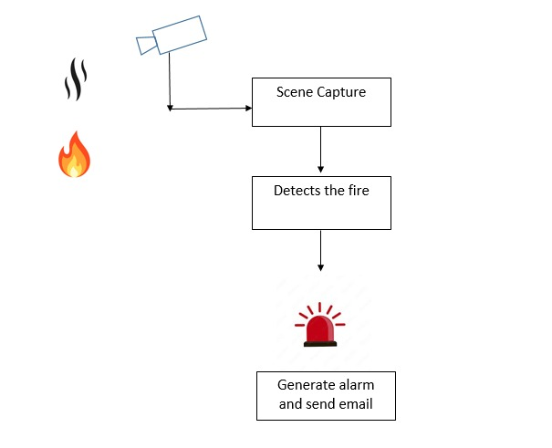
System Design and Methodology

Slide 10
Methodology
Our methodology involves the utilization of the YOLO (You Only Look Once) algorithm for fire detection. This algorithm offers real-time object detection capabilities, making it suitable for our application. We are implementing the system using Python programming language due to its versatility and extensive libraries support.

Slide 11
5- Project tools (or Hardware required)
List any tool required
YOLO
Phython
Vs Code
Google Colab
OpenCV
Hardware requirements
WebCam/Camera
Laptop/Pc with sufficient GPU & RAM

Slide 12
Advantages Of YOLO
High speed and accuracy.
Suitable for real-time applications.
Open-source implementation available (YOLOv5, YOLOv8).
The YOLO algorithm stands out for its efficiency and accuracy in object detection tasks. By dividing the input image into a grid and predicting bounding boxes and class probabilities simultaneously, YOLO enables real-time detection of fire incidents with high accuracy.

Slide 13
Dataset
For training our model, we have curated a comprehensive dataset comprising various fire-related images and videos. This dataset is essential for training the model to recognize different fire patterns and scenarios accurately.
Sources for Fire Image DatasetPublicly available datasets (Open Images, Kaggle).

Slide 14
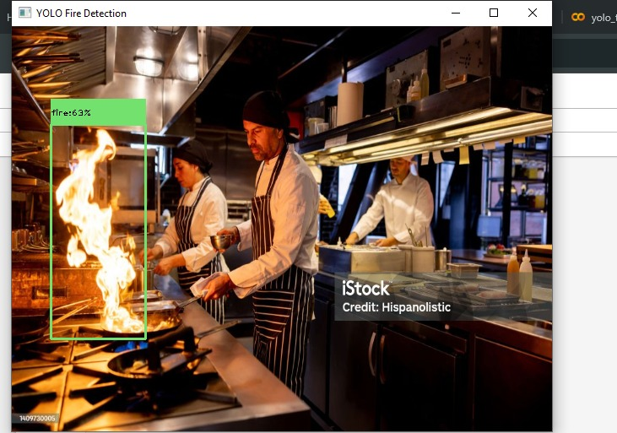
Output

Slide 15
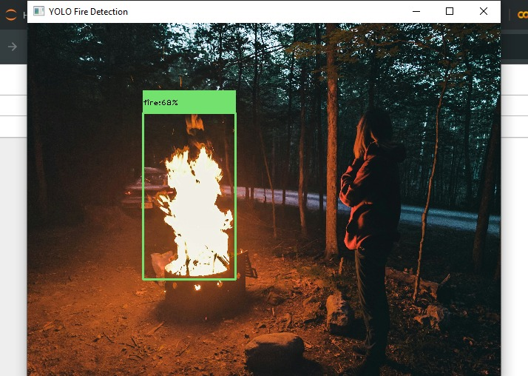
Output

Slide 16
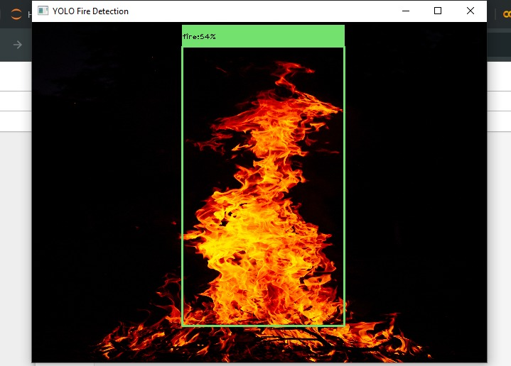
Output

Slide 17


